Slide 1
Dimitris Papailiopoulos
University of Wisconsin-Madison
Communication Bottlenecks and Gradient Quantization

Slide 2
Overview
Distributed ML
Communication Bottlenecks
Possible solutions:
Grad Quantization
Grad Sparsification
QSGD, Terngrad, and beyond

Slide 3
Stores the model
Gradient Computations

Slide 4
Mini-batch SGD

Slide 5






Mini-batch SGD
Batch size B:
#gradients / iteration
+
+
+

Slide 6
Mini-batch SGD
[Zinkevich, Weimer, Smola, Li, NIPS 2010]
[Cotter, Shamir, Srebro, Sridharan, NIPS11]
[Dekel, Gilad-Bachrach, Shamir, Xiao, JMLR 2012]
[Friedlander and Schmidt, SIAM JSC 2012]
[Takác, Bijral, Richtárik, Srebro, ICML 2013]
[Li, Zhang, Chen, Smola, KDD 2014]
[Jain, Kakade, Kidambi, Netrapalli, Sidford, arxiv’16]
[De, Yadav, Jacobs, Goldstein, arxiv’16]

Slide 7
Mini-batch SGD
Repeat iterations until
we train a good model
[Zinkevich, Weimer, Smola, Li, NIPS 2010]
[Cotter, Shamir, Srebro, Sridharan, NIPS11]
[Dekel, Gilad-Bachrach, Shamir, Xiao, JMLR 2012]
[Friedlander and Schmidt, SIAM JSC 2012]
[Takác, Bijral, Richtárik, Srebro, ICML 2013]
[Li, Zhang, Chen, Smola, KDD 2014]
[Jain, Kakade, Kidambi, Netrapalli, Sidford, arxiv’16]
[De, Yadav, Jacobs, Goldstein, arxiv’16]

Slide 8
Reality ~100x worse than optimal
Optimal Speed-up
WHY?
“Large Scale Distributed Deep Networks” [Dean et al., NIPS 2012]

Slide 9
Two factors control run-time
Time to accuracy ε =
[time per data pass] X [#passes to accuracy ε]

Slide 10
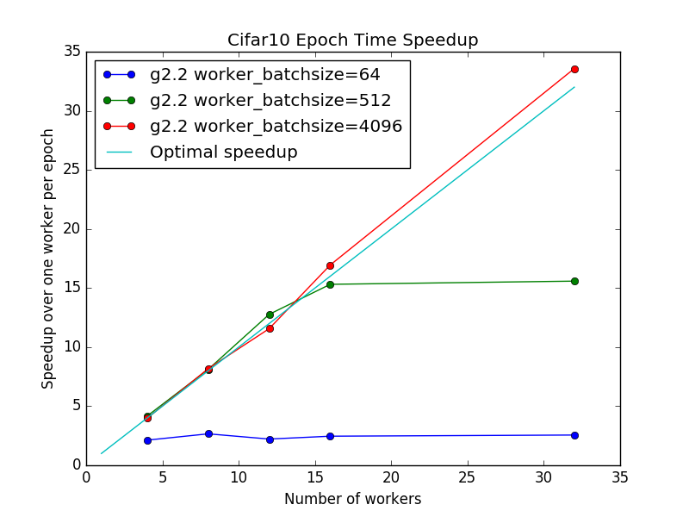

Why so slow?
“[…] on more than 8 machines […]
network overhead starts to dominate […]”
TL;DR: Communication is the Bottleneck
Why?
Time per pass:
time for dataset_size/batch_size distributed iterations
Bigger Batch
Less Communication
(smaller time per epoch)

Slide 11
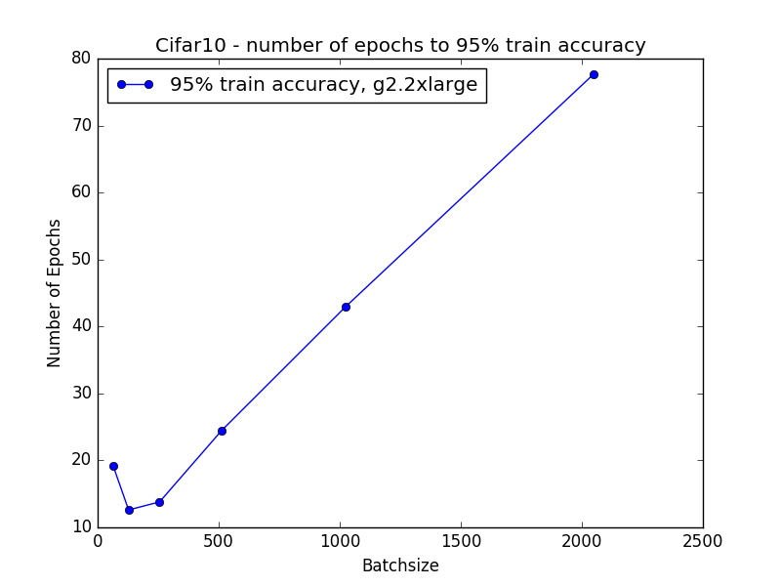
Large Batches?
- If small batch is bad, then maximize it
Large Batch
worse train error
(more #passes to accuracy ε)
Large Batch
=> worse generalization
[Keskar, Mudigere, Nocedal,
Smelyanskiy, Tang, ICLR 2017]

Slide 12
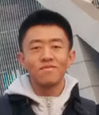
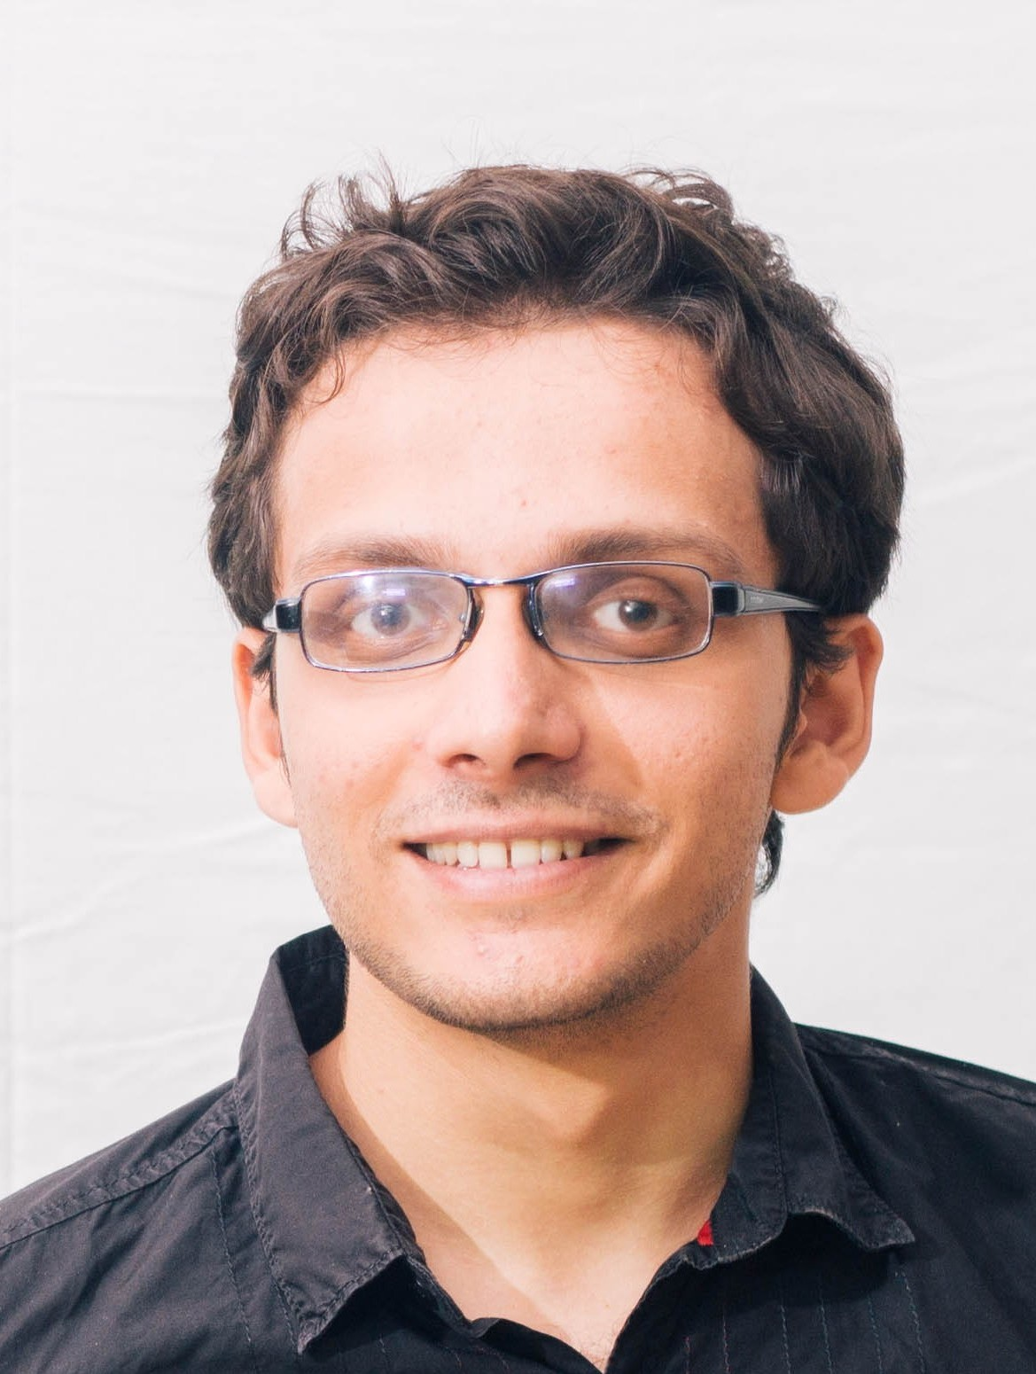
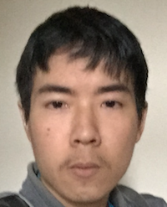
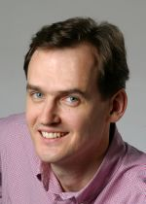
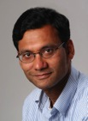
systems perspective: large batch is better
Statistical perspective: small batch is better.
Main Question:
Are big batches fundamentally bad?
Main Contribution:
If batch size is beyond a threshold => worse accuracy
[arXiv:1706.05699]
Joint work
with
Dong Yin
UC Berkeley
Ashwin Pananjady
UC Berkeley
Maximilian Lam
Stanford
Peter Bartlett
UC Berkeley
Kannan Ramchandran
UC Berkeley

Slide 13
Theorem:
After T/B iterations mini-batch SGD
achieves the same accuracy* as serial SGD after T samples, if
Large gradient diversity
Small gradient diversity
High Diversity => Larger Batches => Better Speedup

Slide 14
Big batches beget redundancy
“similar” workload
Workers compute identical gradients => useless! no speedup
Thm:
Problems with high “workload diversity”
More amenable to parallelization.

Slide 15
Gradient Diversity Controls
Distributed Performance

Slide 16
Conclusions
We need
a better algorithm
Novel analysis of minibatch SGD based on gradient interference
Batch size cannot increase beyond a fundamental point
Tight lower bound
Open Problems:
Lower bound for generalization
Fundamental trade-off between parallelizability and statistical accuracy
Stragglers

Slide 17
A better algorithm?
Communication / worker:
O(size of gradient)*32 bits
Q: Lower precision?
O(size of gradient)*4 bits
Q: Sparsification

Slide 18
Some Simple Ideas: Sparsify
3
2
-13
0
7
9
-5
-6
25
-23
0
0
0
0
7
0
-5
0
25
0
Sparsify

Slide 19
Some Simple Ideas: Quantize
3
2
-13
0
7
9
-5
-6
25
-23
1
1
-1
1
1
1
-1
-1
1
-1
Main Question:
Do these ideas work?
Sparsify
Let’s see how they affect SGD’s convergence

Slide 20
Reminder SGD Rates
Setup (ERM):
Algorithm:

Slide 21
Reminder SGD Rates
Setup (ERM):
Algorithm:
Rates = How fast we can reach to a small ball around the opt.

Slide 22
Reminder SGD Rates
Setup (ERM):
Algorithm:
Rates = How fast we can reach to a small ball around the opt.
Let’s make our life easy and assume:
1) The gradient is uniformly bounded
2) The function is strongly convex

Slide 23
Reminder SGD Rates
Setup (ERM):
Algorithm:
Rates = How fast we can reach to a small ball around the opt.
Let’s make our life easy and assume:
1) The gradient is uniformly bounded
2) The function is strongly convex

Slide 24
Reminder SGD Rates
Setup (ERM):
Algorithm:
Rates = How fast we can reach to a small ball around the opt.
Let’s make our life easy and assume:
1) The gradient is uniformly bounded
2) The function is strongly convex
“Any convex function that is l2 regularized”

Slide 25
Reminder SGD Rates
Convergence
- Let’s rename things
Asm. 1
Asm. 2

Slide 26
Reminder SGD Rates
- Let’s expand!
Q: Stepsize and iterations to reach accuracy ε?
A:
= ε/2
= ε/2

Slide 27
High-level requirements
E[Stochastic gradient] = true gradient
Variance M is small, so that SGD doesn’t take too many iterations
Does simple sparsification and quantization satisfy the above?

Slide 28
Uniform Sparsification
3
2
-13
0
7
9
-5
-6
25
-23
0
0
0
0
7
0
-5
0
25
0
Sparsify
P[i,i] is 1 with probability p
Expected sparsity pd

Slide 29
Uniform Sparsification
We can re-write the SGD iteration as
In expectation, we have
How does it perform?

Slide 30
Uniform Sparsification
The variance of the stoch. Gradient is
TLDR:
Communicates pd coordiantes /iteration
Requires 1/p more iterations.
How does it perform?
“Simple” Sparsification does not help!

Slide 31
How about Quantization
3
2
-13
0
7
9
-5
-6
25
-23
1
1
-1
1
1
1
-1
-1
1
-1
Sparsify
Q(g) is not unbiased

Slide 32
Does “unbiasedness” matter?
Yes! Simple example
Assume n = d and
Then,
But,

Slide 33
Does “unbiasedness” matter?
Optimal 0-error solution can be expressed as
i.e., OPT lives in the span of the data
But 1-bit SGD would yield something in the span of the all ones vector

Slide 34
Simple Quantization and Sparsification
Simple ideas don’t work
Hint:
let’s create quantized stochastic gradients, such that:
They are unbiased
They have smaller variance

Slide 35
Unbiased Quantization
Two requirements:
Unbiased estimates:
Small variance
How does it perform?

Slide 36
Easy things first
How do we establish unbiased estimates?
Turn elements “on” with some probability
Normalize by the inverse of prob
How does it perform?

Slide 37
How to be unbiased
I want each coordinate to be –c, c, or 0
- If I want unbiased, we need
How does it perform?
Each coordinate will be on proportional to its absolute value!
C’ has to be the same for all coordinates

Slide 38
How to be unbiased
Each element is “on” with probability
And
Hence, the stochastic gradient should be

Slide 39
Quantized unbiased Grads
The quantized stochastic gradient is
Q: How to pick C?
A: So that it leads to small variance and comm.

Slide 40
Let’s compute the variance

Slide 41
Let’s compute the variance

Slide 42
Let’s compute the variance

Slide 43
Let’s compute the variance

Slide 44
Let’s compute the variance

Slide 45
How do we make variance small?
Each element is “on” with probability
And
And the variance is
How to pick C?

Slide 46
How do we make variance small?
Let’s pick it to be equal to the l2 norm
Then
And the variance is
This means #iterations might increase by sqrt(d) ☹

Slide 47
Sampling induces sparsity
Since
We have
Expected savings wrt to sparsity

Slide 48
QSGD and Terngrad
These quantized variants of SGD where concurrently presented* in
Alistarh, Li, Tomioka, Vojnovic
QSGD: Randomized quantization for communication-optimal stochastic gradient descent. NIPS 2017
Wen, Xu, Yan, Wu, Wang, Chen, Li
Terngrad: Ternary gradients to reduce communication in distributed deep learning. NIPS 2017
*: With different sampling probabilities

Slide 49
Communication: SGD vs QSGD
Total number of iterations
QSGD(ε) < SGD(ε)
Expected bits communicated
QSGD:
SGD (floats):
Expected savings wrt to sparsity
Total Savings ~10x

Slide 50
Performance of QSGD
compute
comm
Beyond QSGD?

Slide 51
Beyond QSGD?

Slide 52
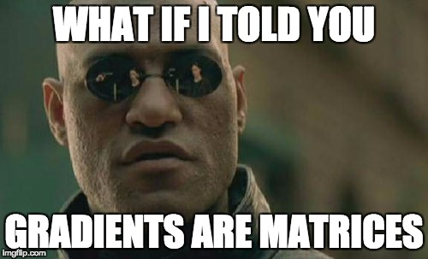
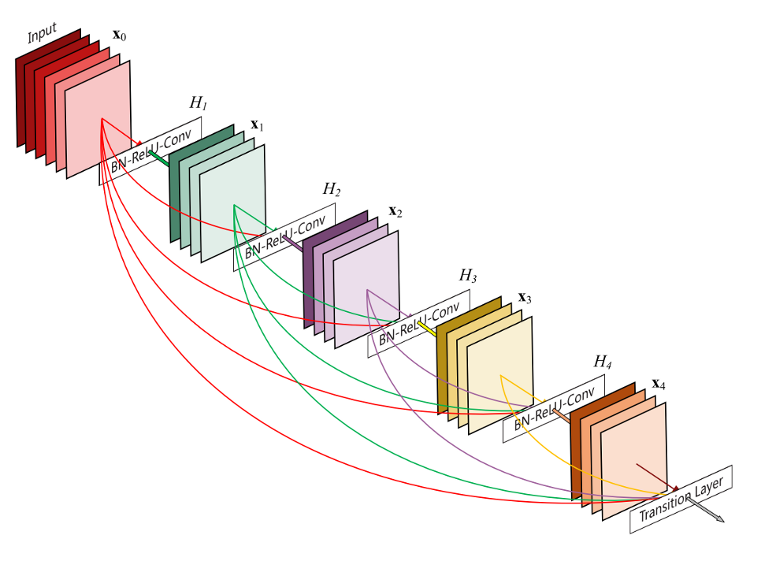
Each submatrix has geometric structure
Quantization does not respect it

Slide 53
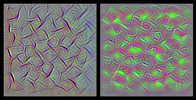
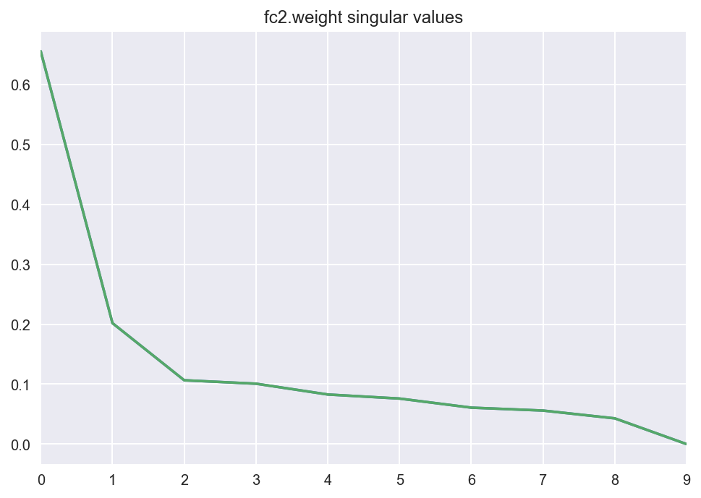
Spectrum of Gradients
Observation: Fast decaying spectral profile (SVD)
What if we quantize in the spectral domain?

Slide 54
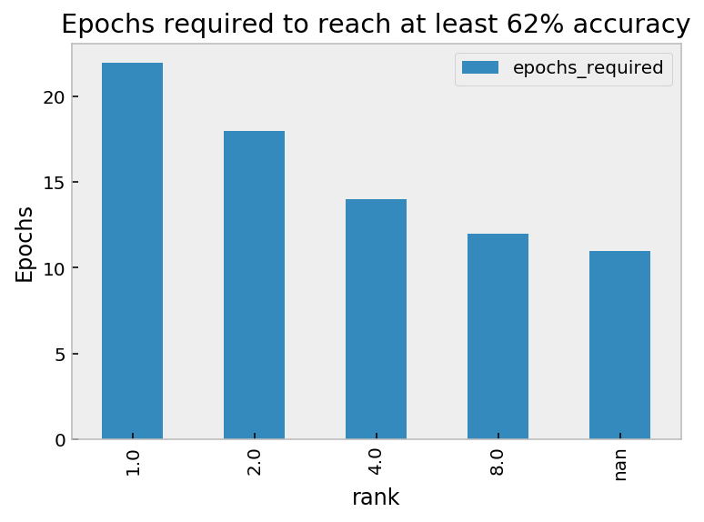
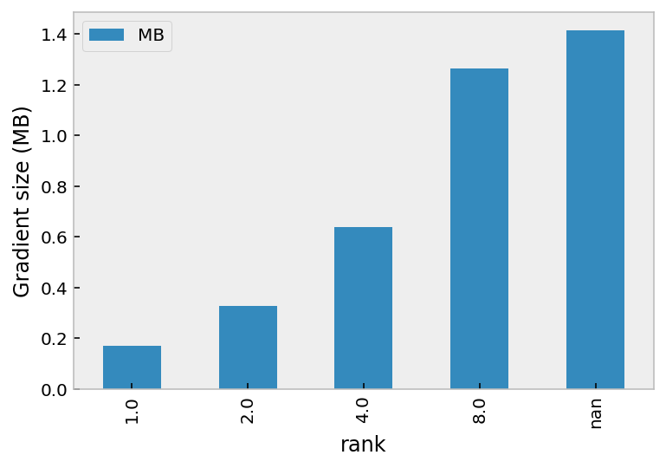
[insert absurd name]-SGD
Step 1: G(i) = Compute Grad at Layer i
Step 2: L(i) = spectrally compressed G(i) (rank-r approx.)
Step 3: Send L(i) to master
2.5x more iterations
8x reduction in communication
Currently testing

Slide 55
Systematic Recipe
Open Problem:
What is the min. variance
StochGrad that is succinct

Slide 56
Conclusions
A long way to go
Novel analysis of minibatch SGD based on gradient interference
Batch size cannot increase beyond a fundamental point
Tight lower bound
Open Problems:
Lower bound for generalization
Fundamental trade-off between parallelizability and statistical accuracy
Stragglers

Slide 57
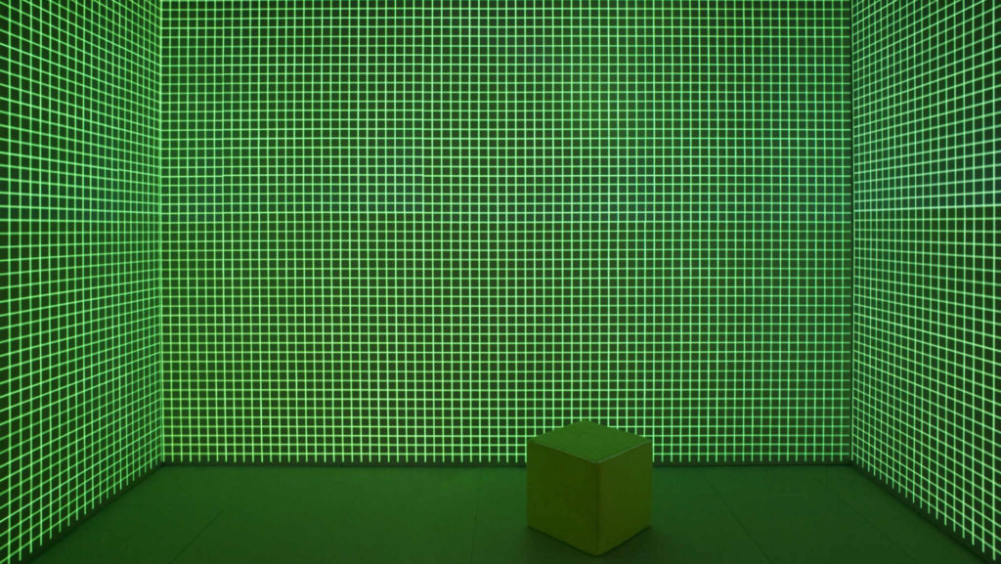
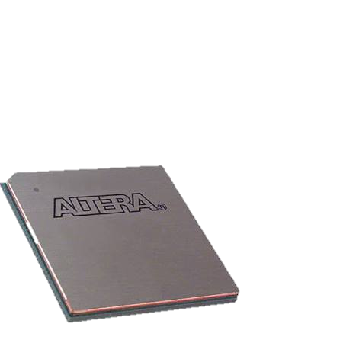
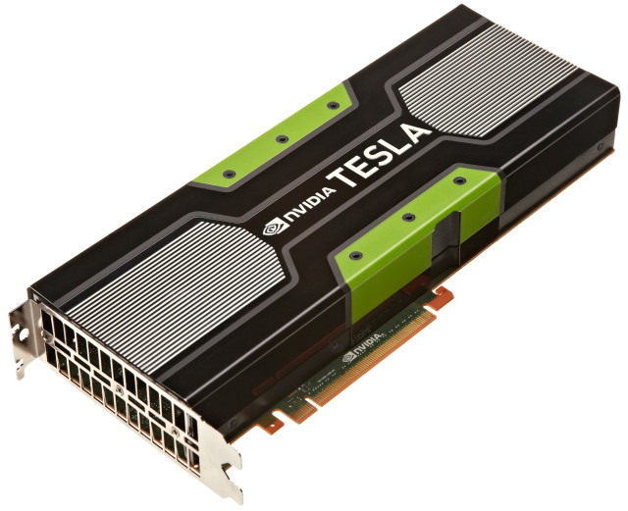
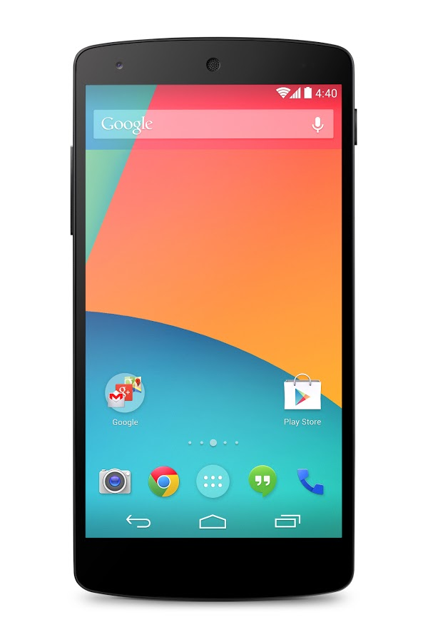
Optimal Quantization?
What is the “optimal” algorithm?
Beyond Master Worker?
Federated Optimization + Security
What is the “optimal” platform?

